Slide 1



Creating the Digital Infrastructure for Waterford Consultants
MNDR - Mark White, Nicholas Wharton, Donovan White, Remo Bose
Sponsor - Ian O’Casey

Slide 2
Problem Overview

Slide 3
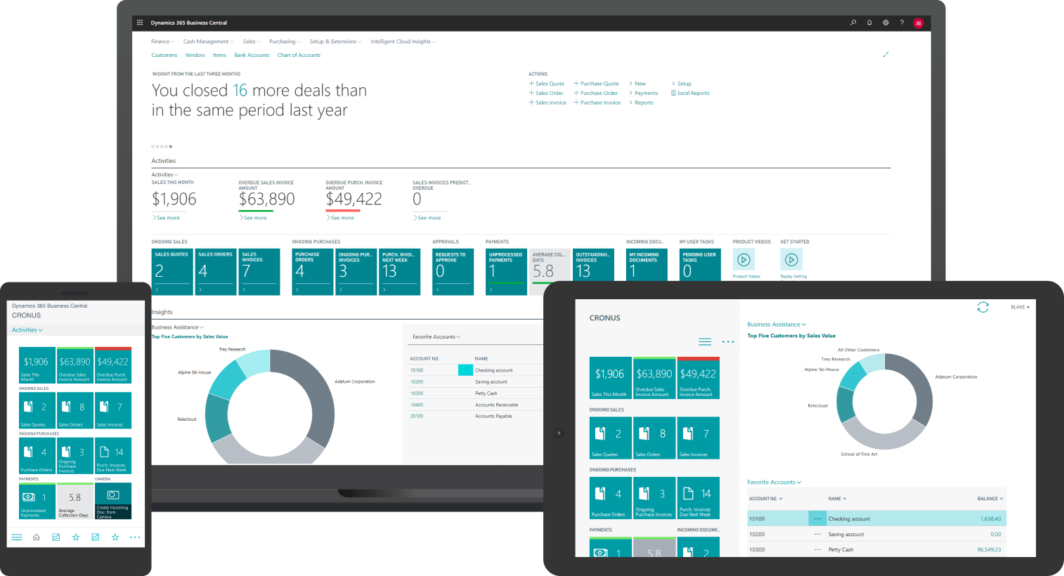
Our client needed a new way of storing information of Waterford’s inventory to make everything more manageable.
Waterford has items they call RIFIS units which can have up to 500 components in each unit.
Each of these components get a serial and lot number associated with them, as they need to be tracked efficiently and accurately.

Slide 4
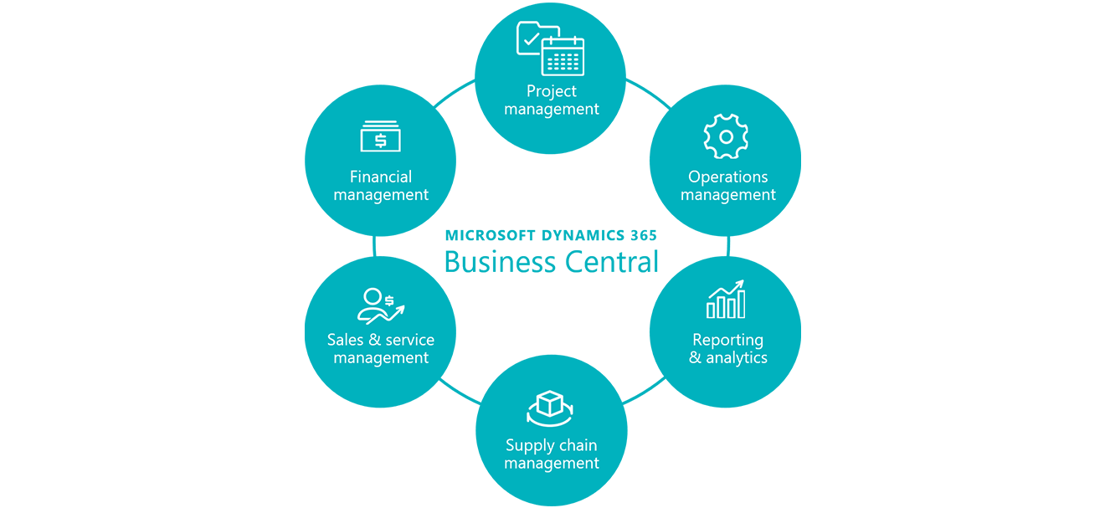

We found the default system functionality has a fundamental flaw: it’s document-based
This means that new ways to receive, store, and access tracking data is required

Slide 5
Our Solution

Slide 6
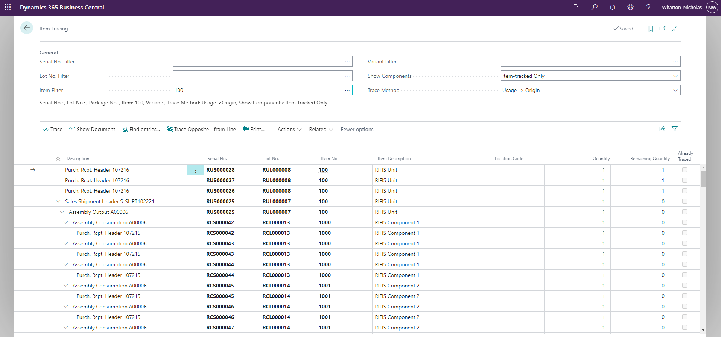
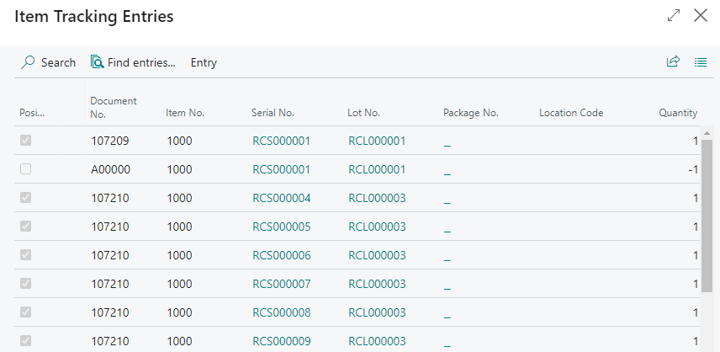
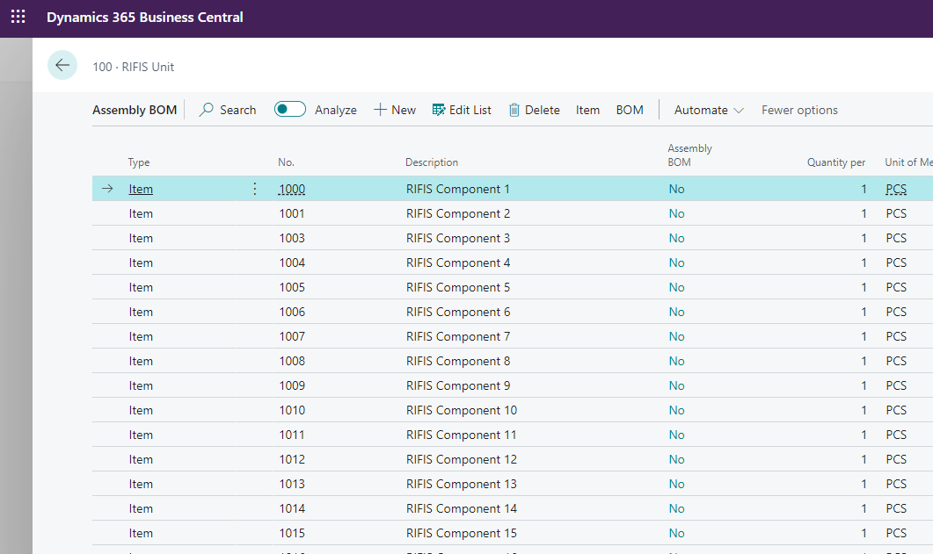
We decided the best approach was to work around the default functionality, so we implemented:
A new Item Tracking Information Input Menu
Newly-configured parameters in the Item Ledger Entries
A new Item Tracing Menu for easy access

Slide 7
Challenges

Slide 8
Frequent shifts between projects and tasks to accommodate our sponsors needs resulted in a lack of consistency, both in our work and focus
However, this did give us experience in meeting with a variety of clients and working under changing circumstances
Consistent communication among all parties
All of the design work was done in a Demo Business Central Environment

Slide 9
Lessons Learned

Slide 10
Solid understanding of BC’s main functionality, along with managing bulk data within a fast-paced, real-world infrastructure
The ability to effectively communicate with professionals when bounded by a limited amount of time
Being flexible to the needs of our sponsor and the company we are providing the project for
Being able to switch gears when things don’t go as initially planned, and adapting to changing circumstances

Slide 11
Questions?

